Slide 1
INCOME AND EXPENSE TRACKER POC

Slide 2
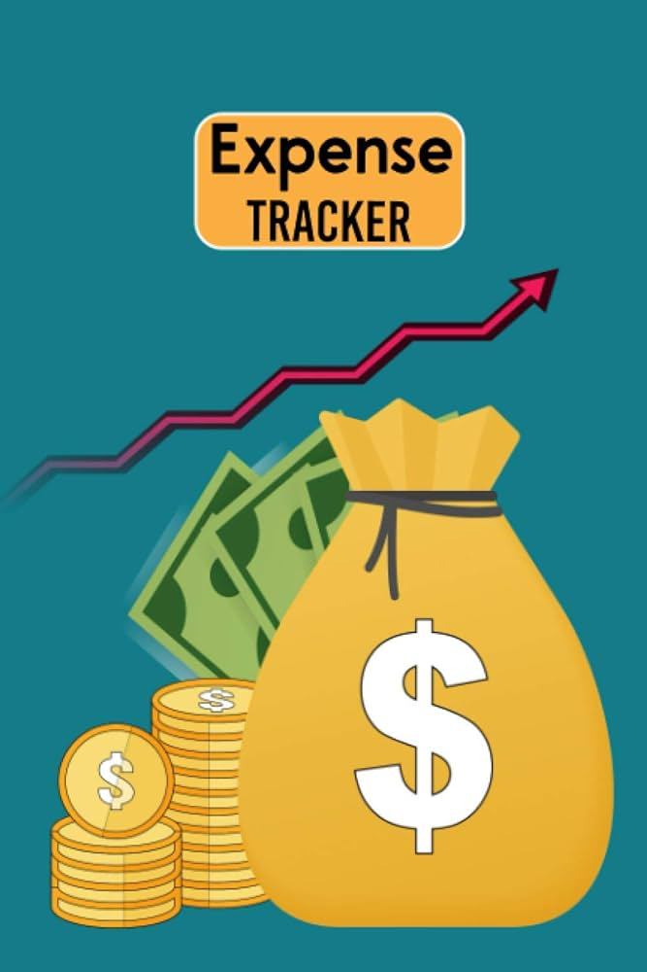

Slide 3
Expense tracking is important in creating a budget for your small business. Keeping a daily record of your expenses by tracking receipts, invoices, and other outgoing expenses improves the financial health of your budget. Tracking expenses can help you stay on top of your cash flow and prepare you for tax season.

Slide 4
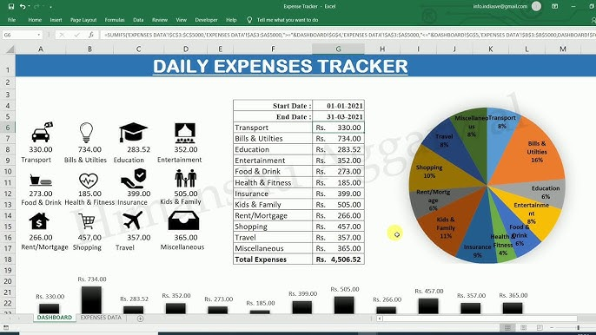

Slide 5
Key Takeaways
Expense tracking helps you take control of your finances and stay on budget
You can organize your expenses into categories like fixed, periodic, and variable spending
It’s helpful to regularly review your expense tracking on a per-project or time-frame system
Creating a budget and tracking your expenses are key to spending in a way that grows your business
Accounting software like an expense tracker app makes it easy to manage your expenses as you go
Here we will cover:

Slide 6
What Is Expense Tracking?
Expense tracking means recording all your expenditures so you have a clear and detailed understanding of your budget. This is typically done for a certain project or over a certain period, so you can stay on budget and make any necessary adjustments.
For many small businesses, expense tracking may include fixed expenses like rent and utilities as well as fluctuating costs like labor, product orders, and advertising. It’s especially important to record one-time and variable costs, as these aren’t always accounted for in the initial budget.

Slide 7
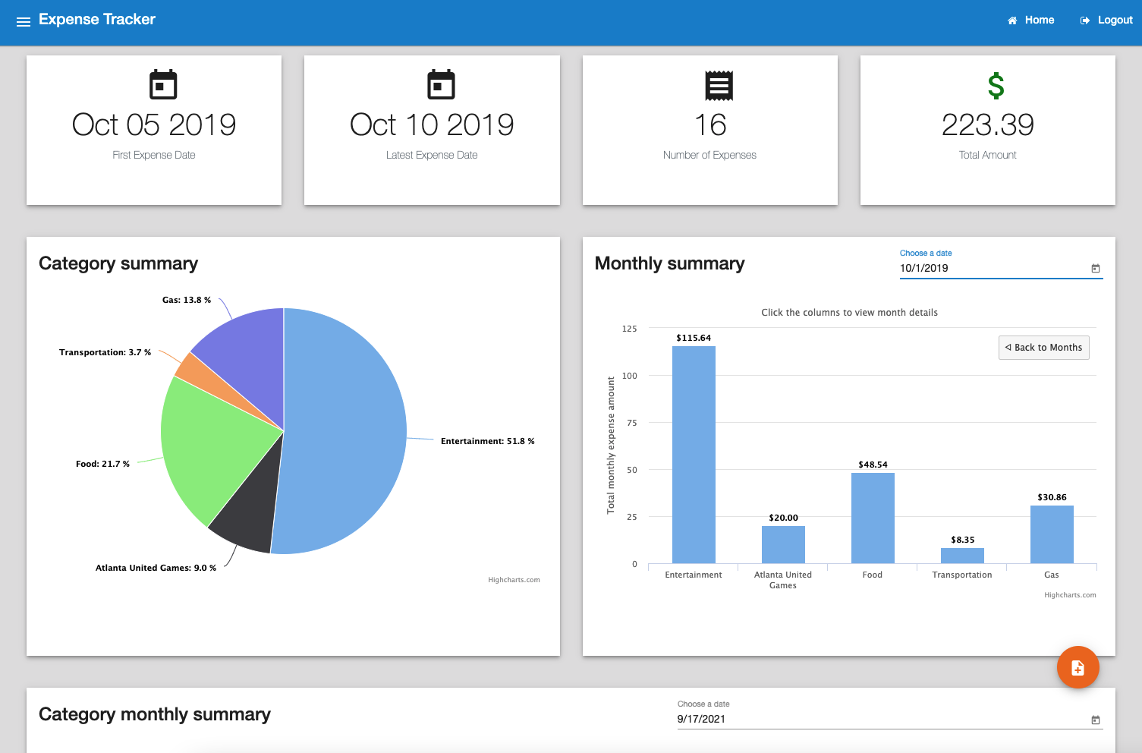

Slide 8
How will Tracking Expenses Help your Business?
Expense tracking helps your business by allowing you to identify and manage spending in an efficient time frame. It’s essential to be aware of your business’s cash flows so you can note any areas of excessive or inefficient spending. When you track your expenses, you can catch these before they get out of hand.
1. Helps you Take Control of Your Finances
Knowing how and when you spend is key to controlling your finances. When you record your expenses, it’s easier to note any spending that doesn’t fit your goals so you can manage your future spending to grow your business.

Slide 9
2. Gives you a Time Frame to Manage Your Finances
Expense tracking isn’t just for knowing where your money goes — it’s for adjusting your spending promptly to suit changing business needs. When you record your expenses within a certain time frame, it’s easy to review your spending and decide what to keep and cut.
3. Tracking Your Expenses Makes You a Better Money Manager
As a business owner, staying on top of your monthly budget is crucial to success. There is no better way to manage your budget and know where your money is going than expense tracking.
Recording your expenses daily can ensure that you are financially aware all year long and not just during tax season. Knowing where your money is going and how much you’re spending can improve your spending habits. Plus, you’ll better understand where you can allocate money to positively impact your bottom line.

Slide 10
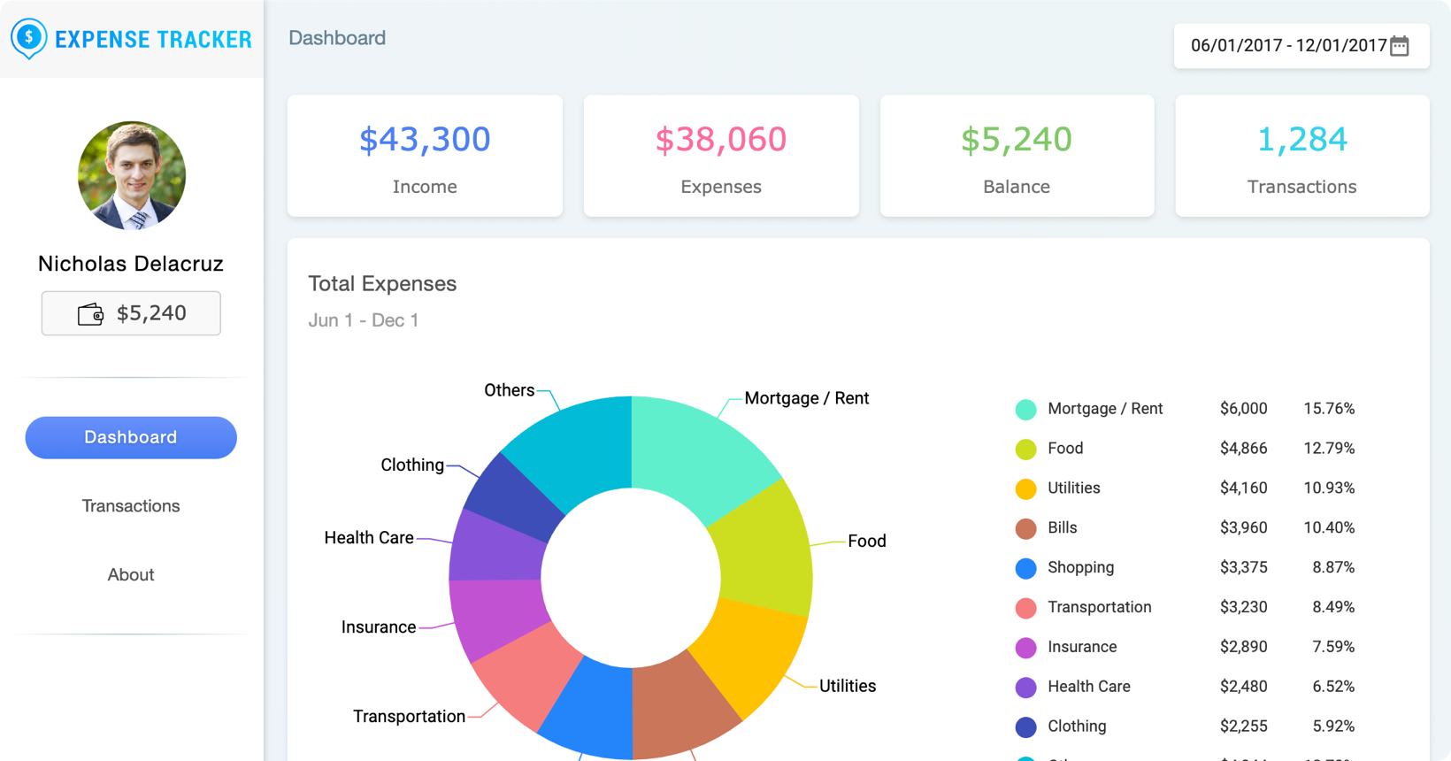

Slide 11
4. Become Aware of Poor Spending Habits
Industries can change quickly, and it’s easy for old expenses and practices to become obsolete. Expense tracking gives you an easy way to record and understand all of your spendings and review it in a timely manner.
Tracking your spending helps you identify any expenses that might be unnecessary or excessive. It also gives you a time frame for this review, so you can cut unhelpful spending practices before they become too costly.

Slide 12
5. Expense Tracking Makes Business Forecasting Easier
When you record your expenses, it’s much easier to calculate the profitability of your business. The equation is simple: revenue minus expenses.
You can offer potential investors a better idea of your company’s profitability by offering them a better idea of how your business is doing. You don’t have to make an educated guess about your finances when you’re tracking your expenses. You can offer stakeholders a clear picture of your business forecast and strategy with up-to-date expense tracking.

Slide 13
Elements of a Budget Process
1. Income Source
Where is your money coming from?
Knowing all your incoming revenue sources is a great first step in successful money management. Start with your sales figures and then factor in other sources of income that you are using to run your business.

Slide 14
2. Fixed Costs
What costs are you paying every month?
Creating expense reports for regular monthly costs like bills and subscription costs is often the easiest part of creating your business budget. These fixed costs are usually the same price every month and can be easily added to your operating plan.

Slide 15
3. Variable Expenses
What are some costs that you can adjust as you go?
Variable costs are items that don’t have a fixed monthly price. Often these purchases can be scaled up and down to work with your monthly operating budget. Depending on your profitability, you can scale up or down with these purchases as you see fit.
4. One-Time Purchases
Do you have the money for an unexpected purchase?
After you have factored in all your income sources and fixed and variable costs, you can see what you have available for one-time purchases.
Leaving breathing room in your budget can help you enjoy perks like taking an educational course to improve your business knowledge or prepare you for unexpected costs like replacing equipment that might have broken down.

Slide 16
How Do You Track Expenses?
As you know by now, tracking your business expenses is essential to the success of your business. Whether you’re preparing for tax season or trying to get a better idea of where your money is going, daily tracking is beneficial to your business. Here are a few steps to get you started on tracking your expenses.

Slide 17
1. Track your Expenses Regularly
Part of what makes expense tracking so helpful is that it encourages you to regularly review your spending. Whether you choose to track by the project or within a given time period, set yourself regular times to go over your expense tracking so you can make any adjustments in an efficient time frame.

Slide 18
2. Categorize your Expenses
Keep your expense tracking organized by dividing your expenses into different categories based on your business needs. You may choose to categorize based on fixed, variable, and one-time expenses, or you may use another method like necessary expenses and preferred or flexible spending.

Slide 19
3. Open a Bank Account
Keep your life simple by separating your business income and expenses from your personal finances. Muddling the two could be disastrous for the financial health of your business operations and complicate your personal finances too.

Slide 20
4. Save Your Receipts
Save time and ease your mind during tax season by keeping your receipts.
Using one credit or debit card for your business-related purchases will help streamline your expensing tracking. There are also convenient features on accounting apps and software that let you take pictures of your receipts to store them on the cloud.

Slide 21
Managing your expenses is easier when you know where time is being spent. Keep track of your and your employees’ time sheets and discover which clients and projects are taking the greatest time.

Slide 22
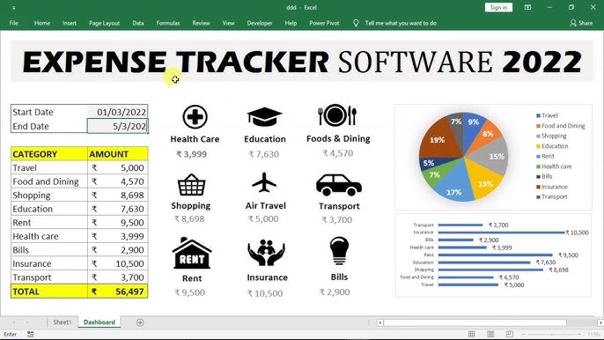

Slide 23
Conclusion
Expense tracking is a helpful practice for managing your business spending. By recording and reviewing your spending on a regular basis, you can identify any excess expenses, stay in line with your business goals, and be well prepared for tax season.

Slide 24
There are multiple ways to organize your expense tracking–you might choose to categorize your spending into fixed and variable expenses or divide it into essential and flexible spending. You can also track your expenses by project or by time period. Both systems encourage you to review your spending regularly, so you always know when and how your money is spent.

